Slide 1


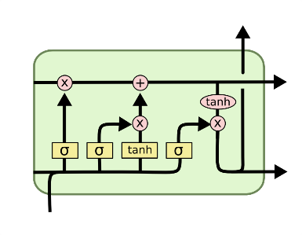
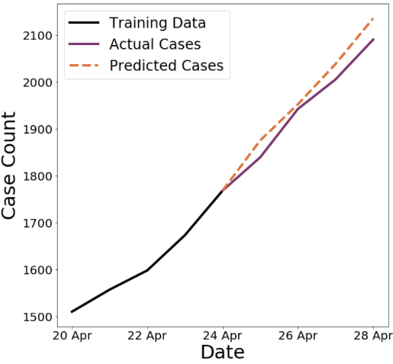
Predicting COVID-19 Case Counts
Extensible and Geographically-Precise Predictive Modeling with LSTM Networks
Overview
The COVID crisis has highlighted shortcomings in the healthcare systems of many countries.
One major problem in the US in particular is the lack of tests, PPE, and clinical personnel in the right places.
The ability to anticipate where cases will arise would be a powerful tool in mitigating these issues.
This document summarizes the development of a predictive model to forecast COVID cases by US county.
Methodology
Primary dataset: COVID case counts published daily by Johns Hopkins University.
This dataset contains detailed case and death counts by day for each US county.
There are many modeling frameworks designed for time series forecasting, both traditional and modern.
LSTM nodes have “memory” and are able to capture nonlinearities and other subtleties in time series data.
Train the LSTM on case count sequences from every county in the US with 100 or more confirmed cases.
Schematic of LSTM Node
Results
Next-day case predictions have a mean absolute percentage error of 2.6%.
Prediction quality decreases as the forecast is extended forward in time.
Increasing the sequence length reduces this decay in prediction quality.
The model is able to capture features of the case count trajectory,
including case spikes, inflection points, etc.
Model can be retrained for better accuracy as the pandemic continues.
Example prediction for Franklin County, Ohio
Enhancements and Future Steps
Supplement case counts with county-specific data, such as demographics and “social determinants”.
Account for external factors such as stay-at-home orders, the presence of at-capacity hospitals, etc.
Forecast the need for PPE, hospital beds, and clinical personnel based on the predicted case counts.

